Slide 1

Matthew Gerloff
Laptop Price Prediction Model

Slide 2
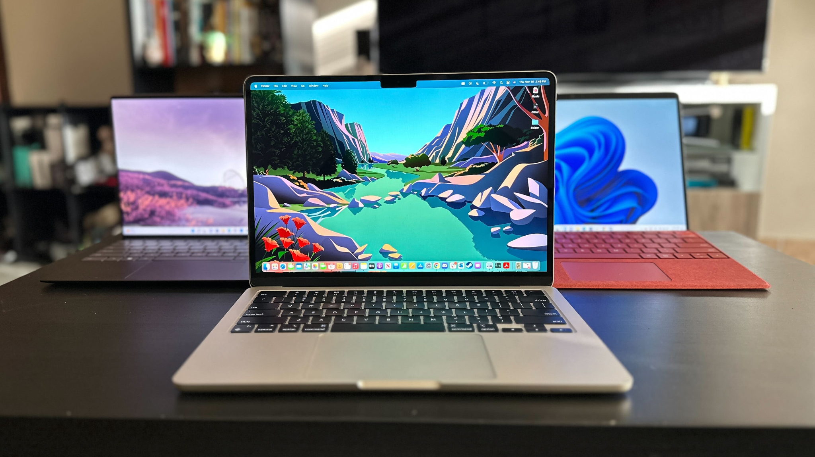
About SwiftLap
Looking to compete in high-end laptop market
Prioritizes quality
Goal of offering latest technology to consumers
Target customers are professionals and gamers
Needs help with pricing, analysis and strategy

Slide 3

The Model
SwiftLap created a predictive model that could accurately guess the price of a laptop when given the following data:
Company
Ratings
No. of Ratings
No. of Review
Size
RAM
MRP (Manufacturer’s Recommended Price)

Slide 4

Advantages
The model has provided advantages for SwiftLap in these areas:
Pricing Strategy
Competitive Analysis
Product Development
Marketing Strategy

Slide 5

Pricing Strategy
SwiftLap now uses the features included in the model to determine optimal price ranges for their laptops. By setting prices that align with the predicted values from the model, they are able to increase sales and revenue totals.
Value created by avoiding charging less than the market is willing to pay.

Slide 6
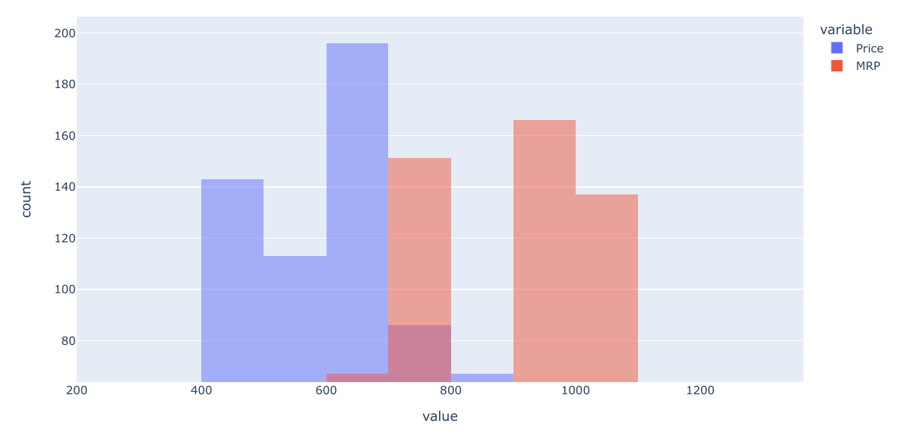
Competitive Analysis
Using data from the model, SwiftLap can compare prices of their laptops with that of their competitors. This allows them to identify areas where they can change their pricing strategy to be more aggressive and capture a larger market share.
Value created by charging less than competitors to gain market share.

Slide 7
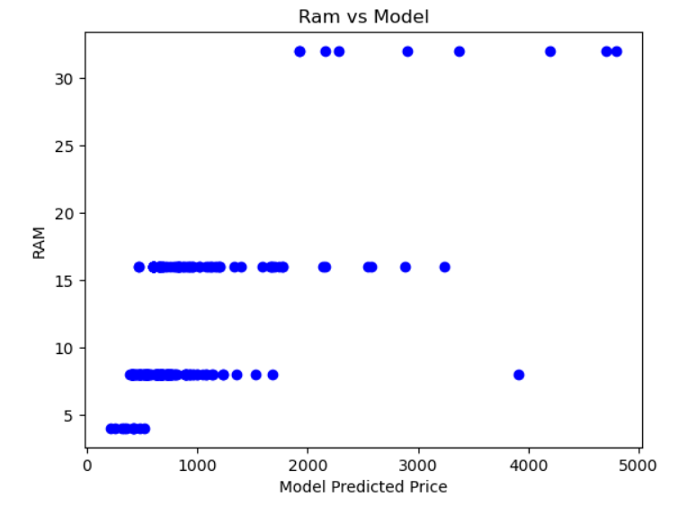
Product Development
By analyzing the model, SwiftLap can determine the importance that each feature has in the overall price of a laptop. By understanding which features have the highest impact on price, they could potentially develop products that are more attractive to their target market.
RAM has a high positive correlation with an increase in price.

Slide 8

Marketing Strategy
Swiftlap uses the model to identify target customers who are more likely to purchase their laptops when certain features are included. This allows them to create more targeted marketing campaigns to increase their chances of converting potential customers into buyers.
Model shows most popular features
Popular features get advertised
Features become even more popular

Slide 9
Results
Using the Predictive Pricing model, SwiftLap has been able to successfully grow its company, leaning on the advantages gained in the areas of Pricing, Analysis, Product Development, and Marketing Strategy. Today, SwiftLap considers the model a valuable asset and will continue its use going forward.

